Slide 1
Artificial reefs as refuge habitats for climate-threated species

Slide 2
Updates:
Omitted cucumbers from this updated review
Incorporated data from VRG 2024 surveys
We’d like to focus on wasting as the impact event and see if there’s any pattern of density increase on the PVR modules rather than natural reefs nearby PVR
Density plots include data directly from the PVR modules (not previously included in my thesis)
Need to include 2010.. Getting omitted for some reason in the PVR sites

Slide 3
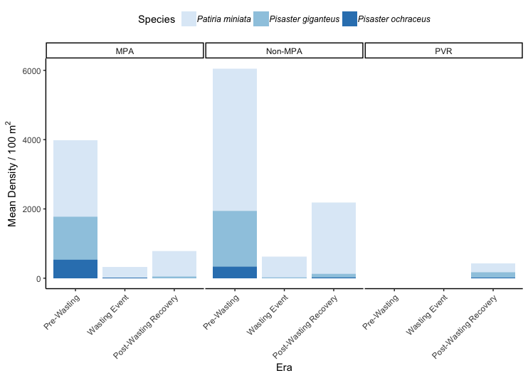
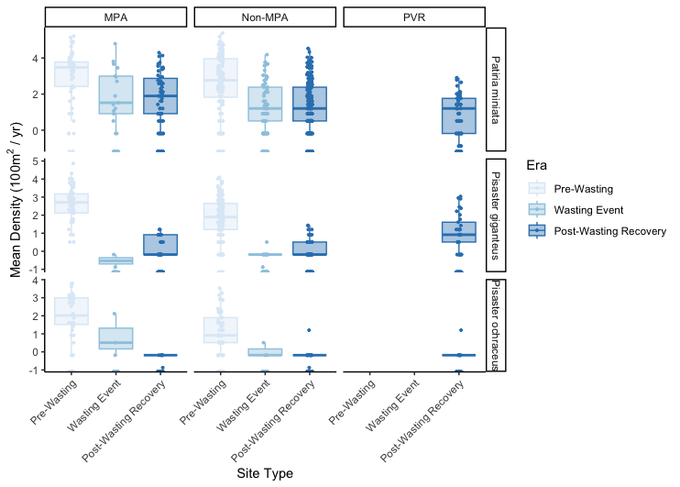
Sea Star Overview
Figure 1. Mean species density (per 100 m² per year) for P. miniata, P. giganteus, and P. ochraceus, by site type: MPA, non-MPA, and artificial reef PVR, and era: pre-wasting (2008–2013), wasting (2014–2016), and post-wasting (2017–2024).
Figure 2. Comparison of mean species density per 100m² across site type and era for P. miniata, P. giganteus, and P. ochraceus
Notes:
*alter the per 100m2 in the stacked plot to say (per 100m2)

Slide 4
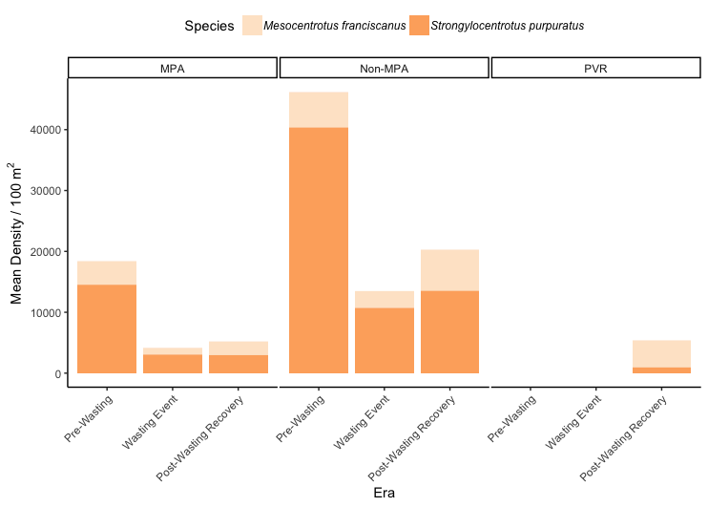
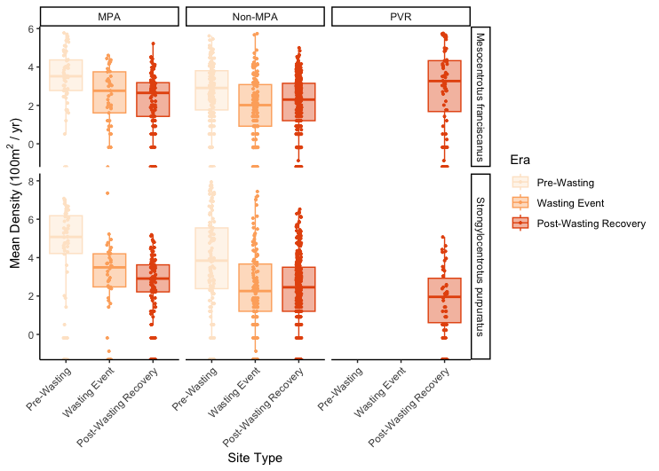
Urchin Overview
Figure 3. Mean species density (per 100 m² per year) for M. franciscanus and S. purpuratus, by site type (MPA, non-MPA, and artificial reef PVR) and era: pre-wasting (2008–2013), wasting (2014–2016), and post-wasting (2017–2024).
Figure 4. Comparison of mean species density per 100m² across site type and era for M. franciscanus and S. purpuratus.

Slide 5
Site List
Impact: Implementation of MPA
Impact: Implementation of PVR
Control Sites:
Hawthorne Reef
Marguerite Central
Albondigas
Marguerite East
Golden Cove
Resort Point
Portuguese Bend
Impact Sites:
Long Point East
120 Reef
Abalone Cove Kelp West
Long Point West
Old Marineland
Point Vicente West
Portuguese Point
Control Sites:
Hawthorne Reef
Honeymoon Cove
Lunada Bay
Resort Point
Rocky Point South
Rocky Point North
Ridges North
Impact Sites:
KOU Rock
Old 18th
Burial Grounds
Cape Point
3 Palms West
3 Palms East
Bunker Point

Slide 6
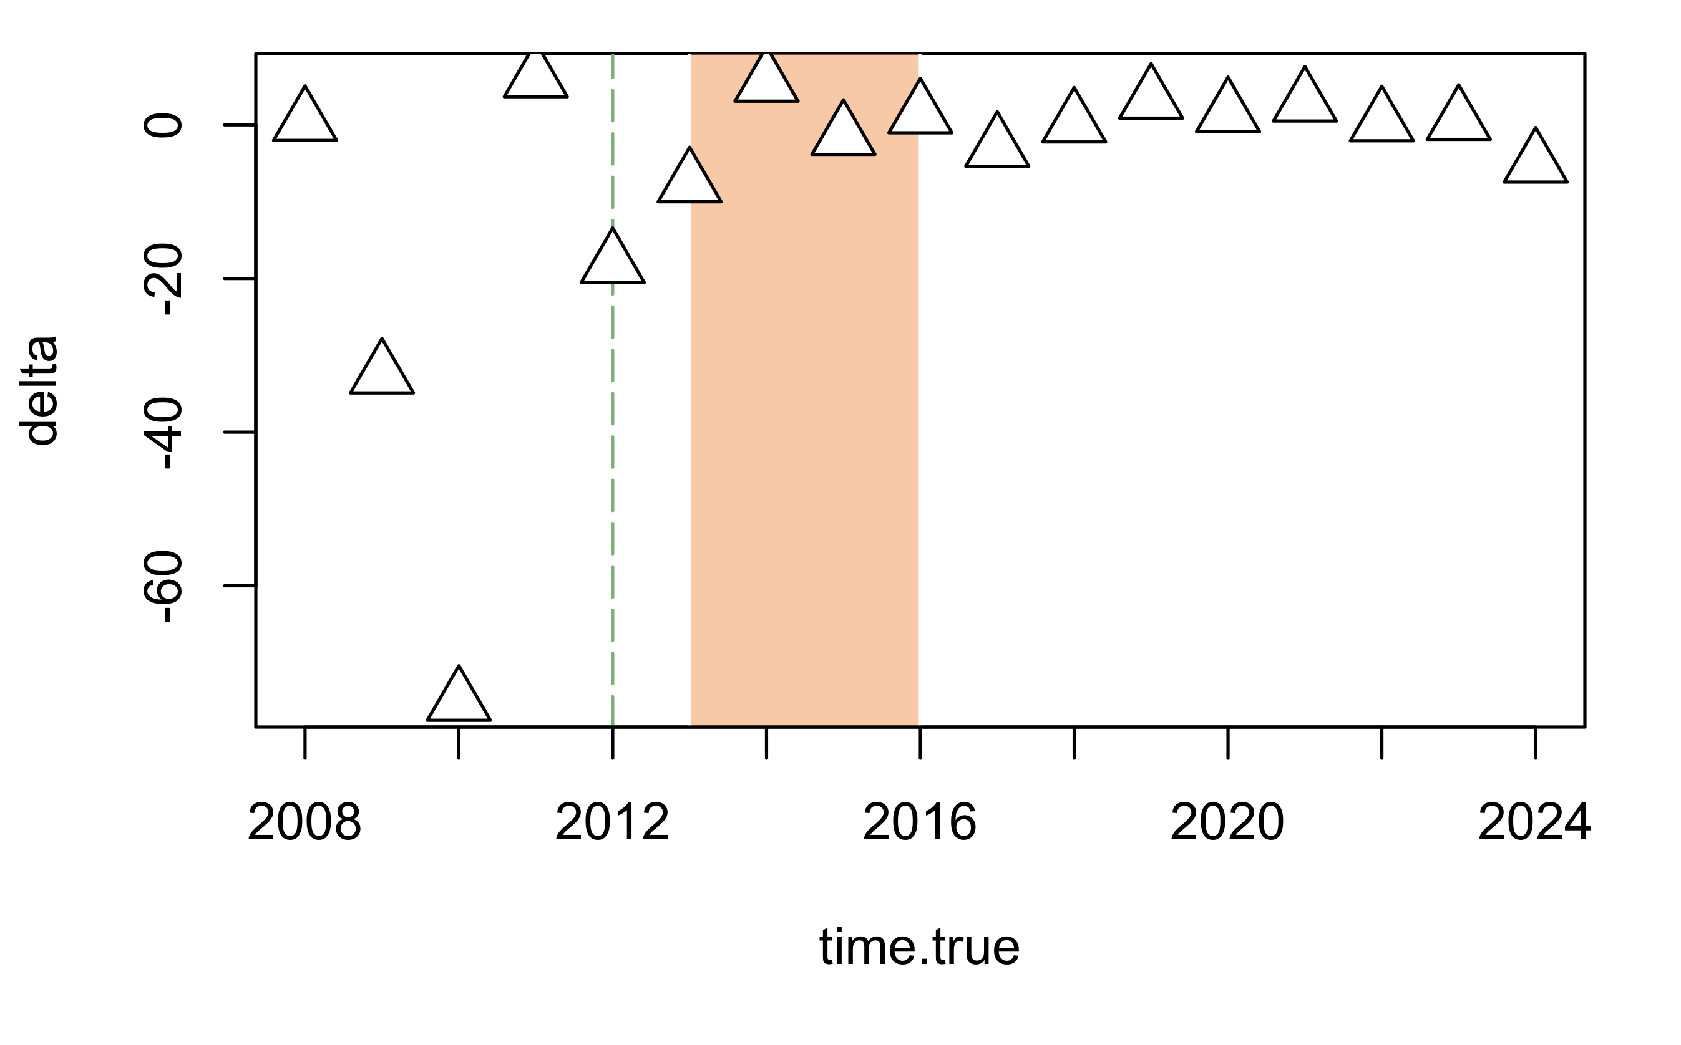
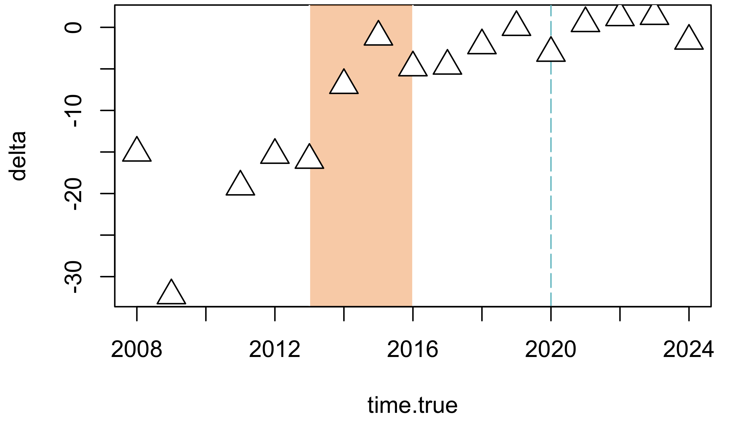
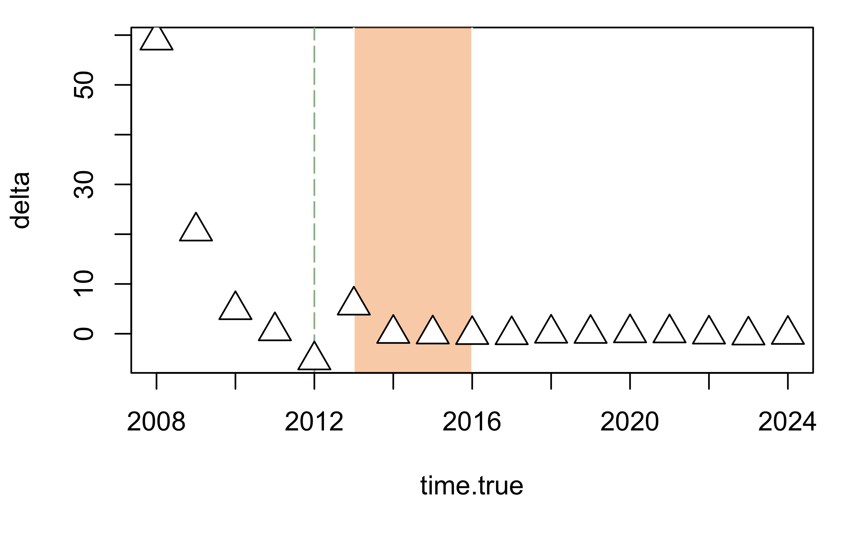
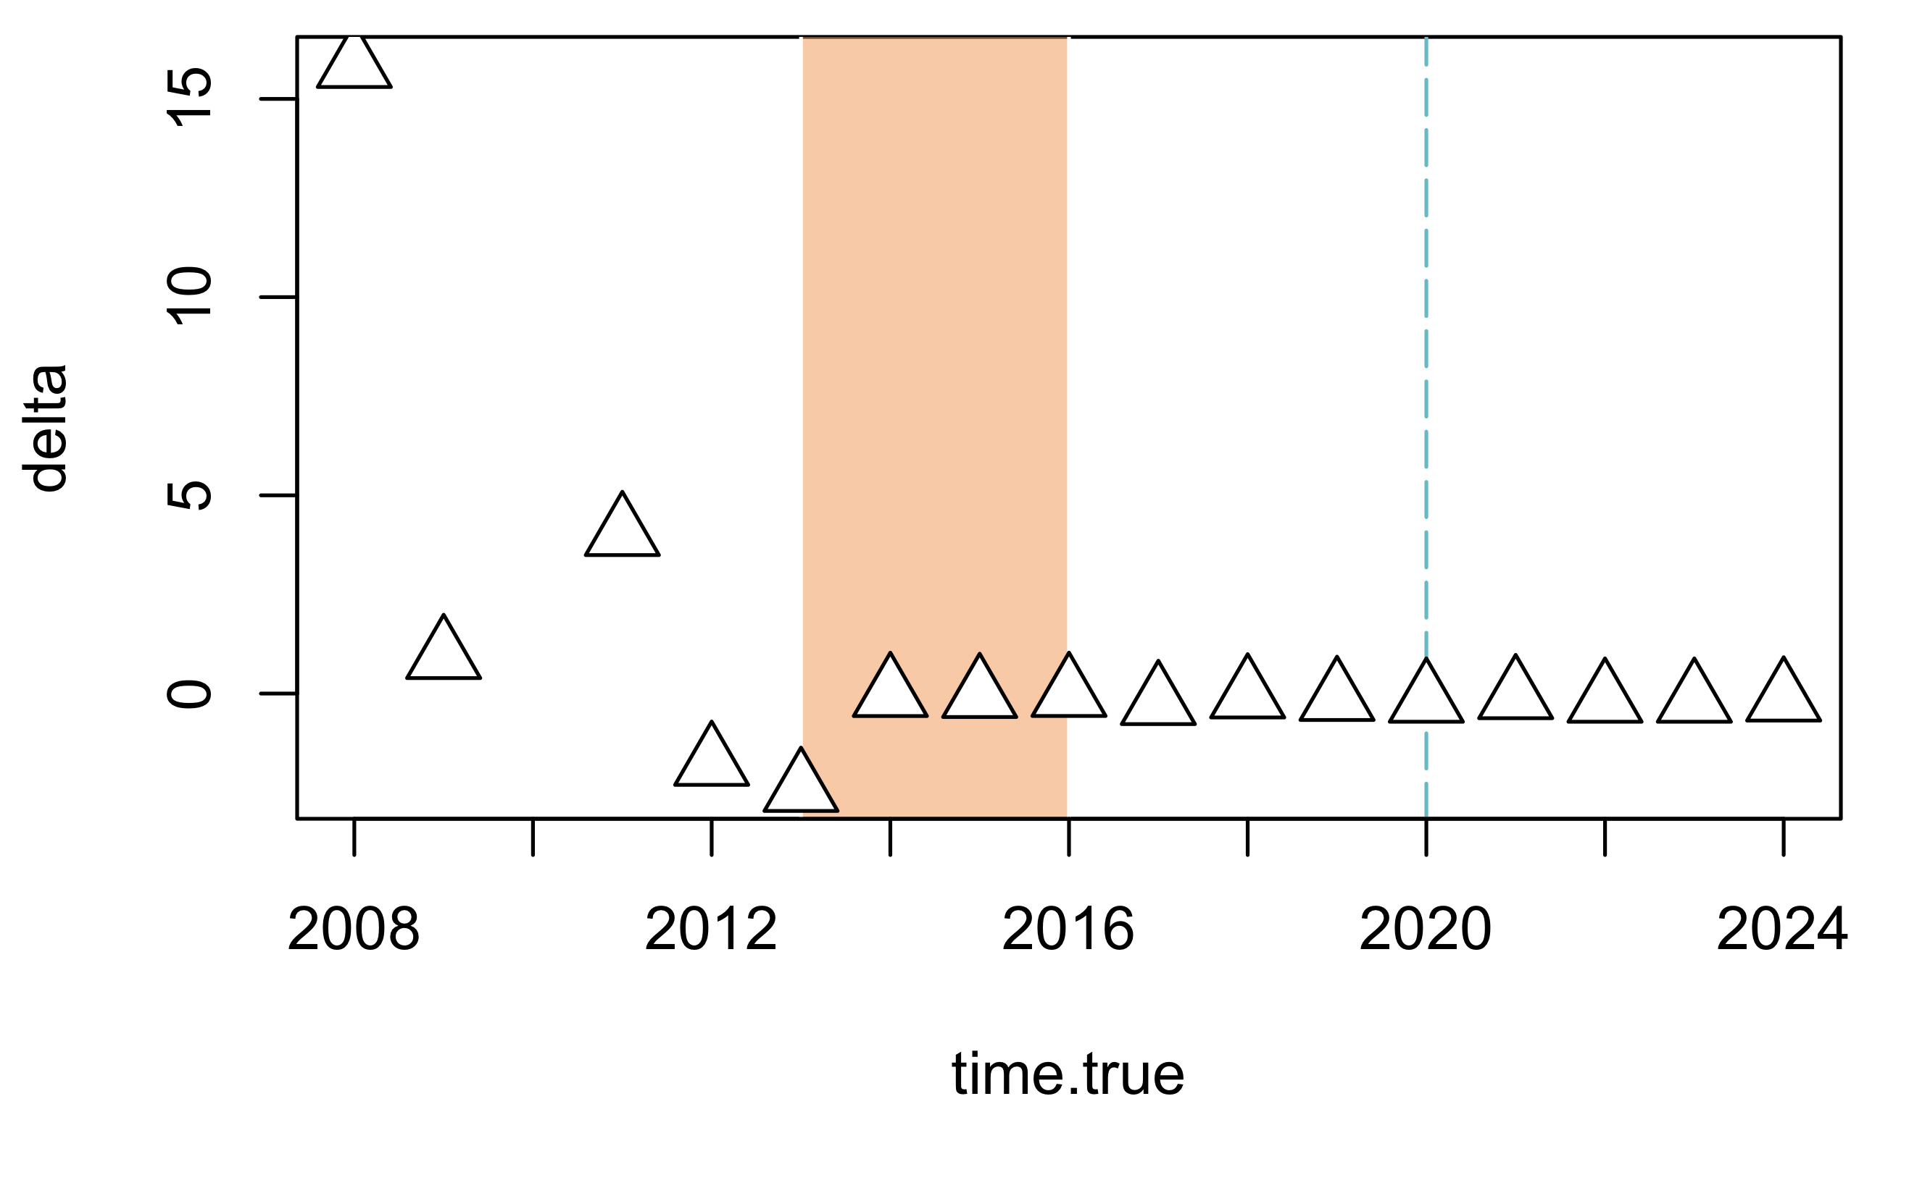
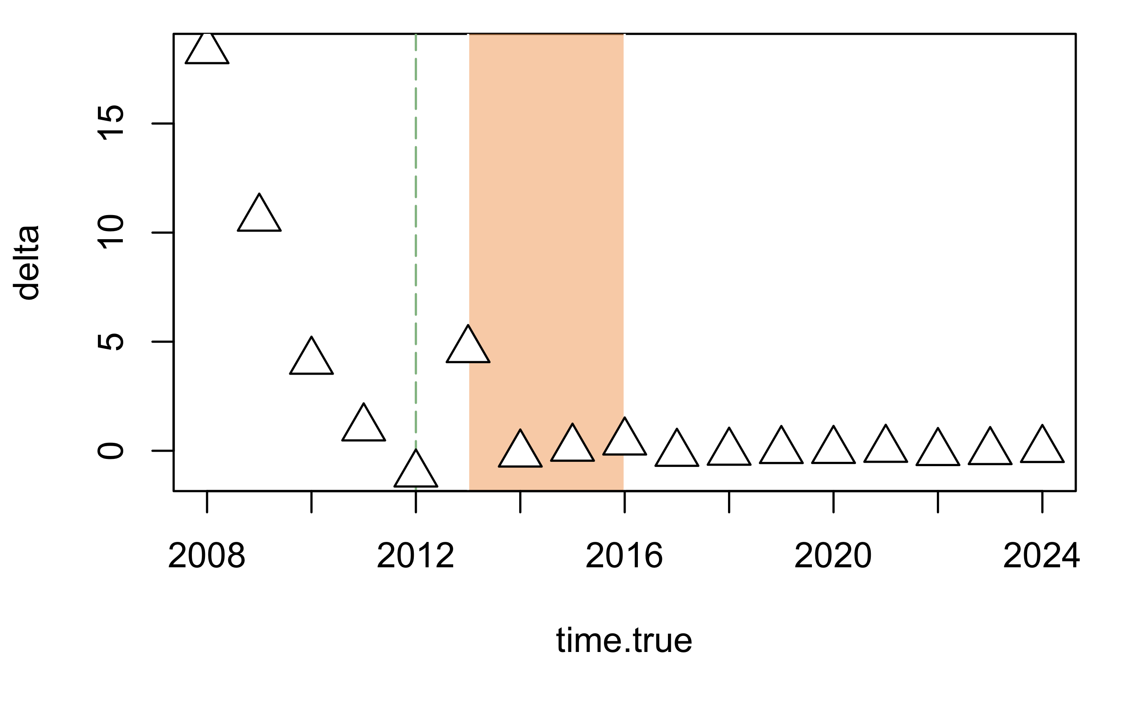
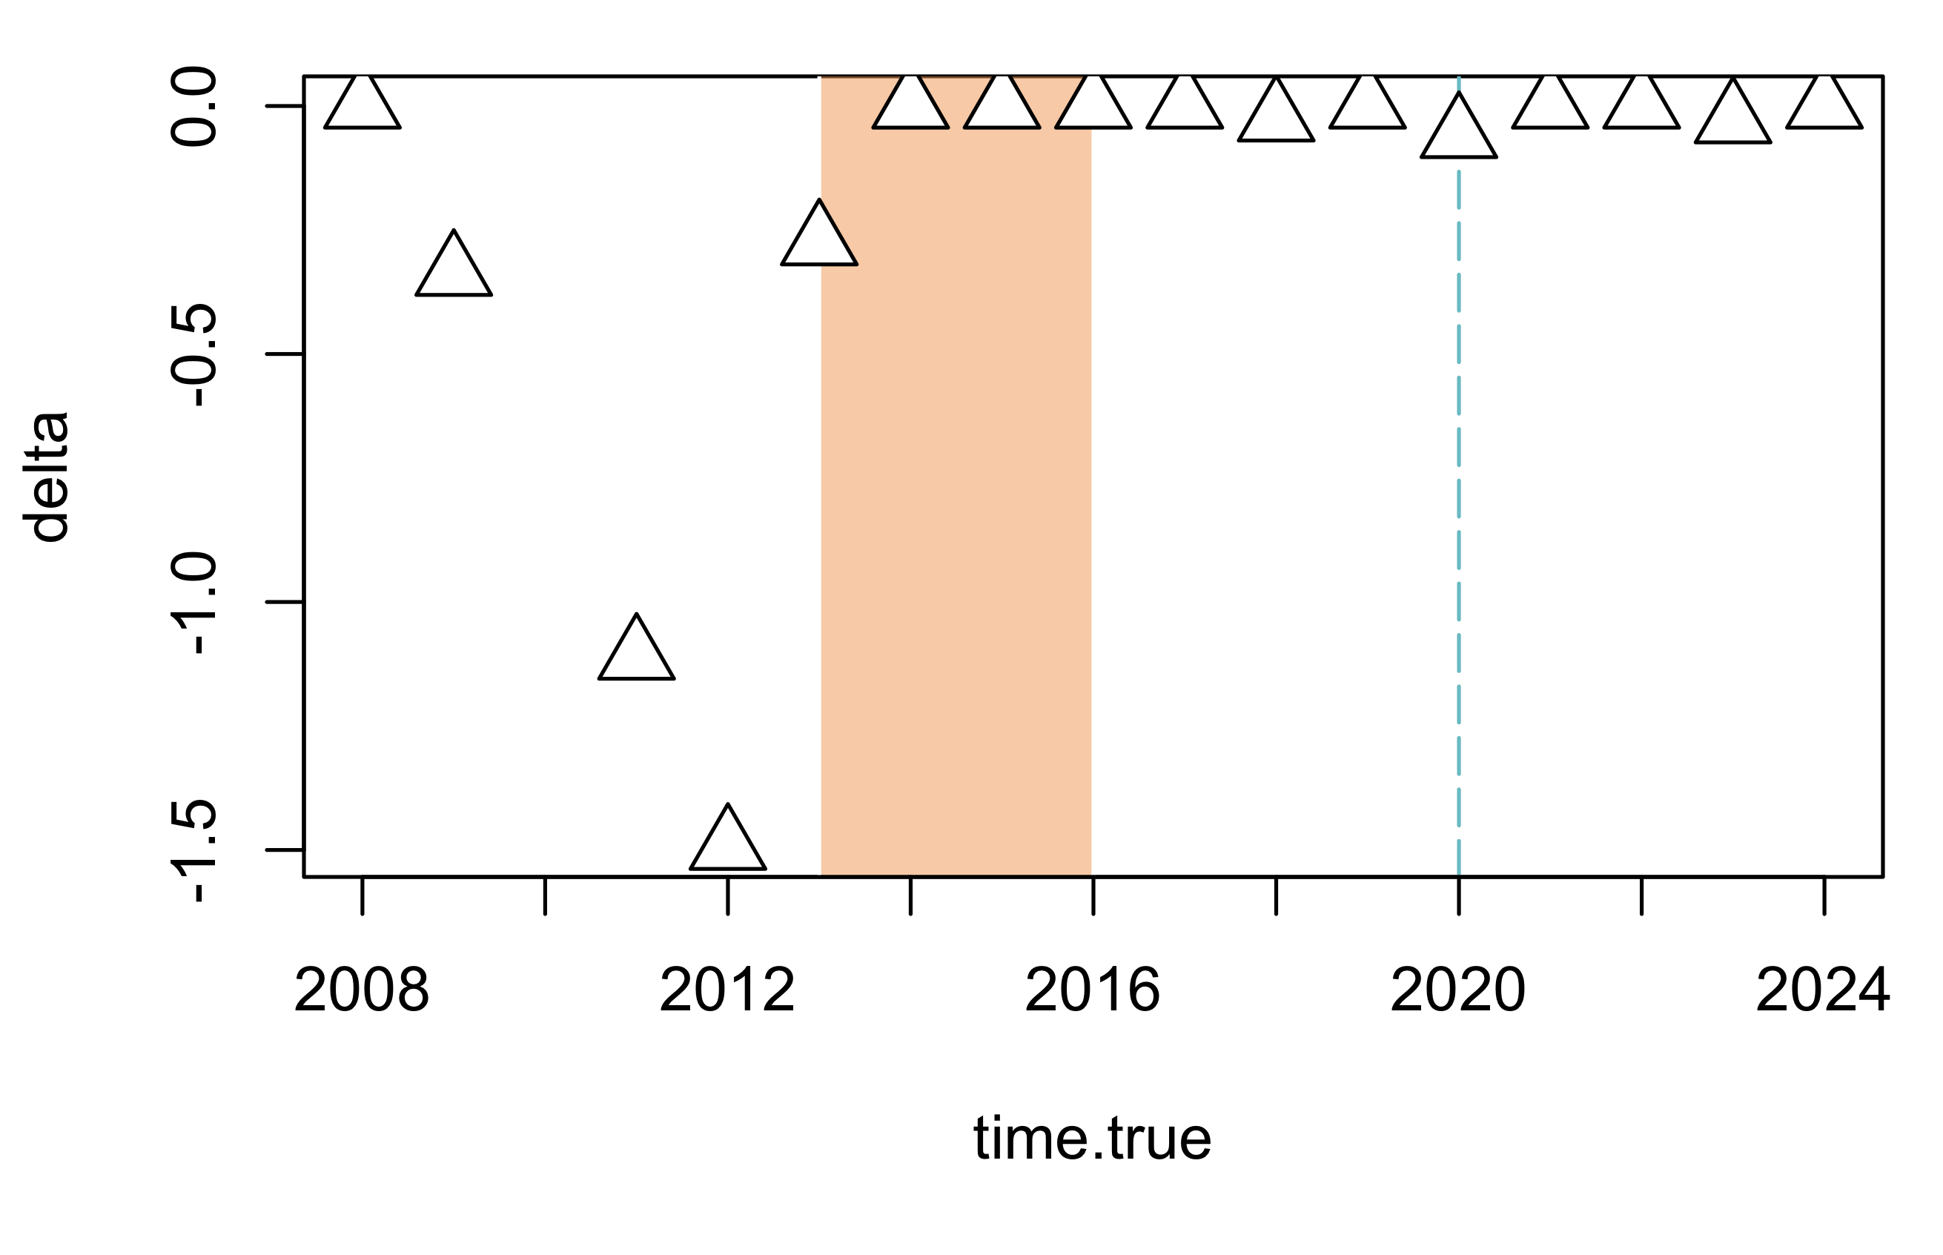
BACIPS Overview - Stars
Impact: Implementation of MPA
Impact: Implementation of PVR
Step Model, 82.2% likelihood
Sigmoid Model, 68.6% likelihood
P. miniata
Step Model, 73.6% likelihood
Step Model, 94.7% likelihood
P. giganteus
Step Model, 72.6% likelihood
Step Model, 86.5% likelihood
P. ochraceus

Slide 7
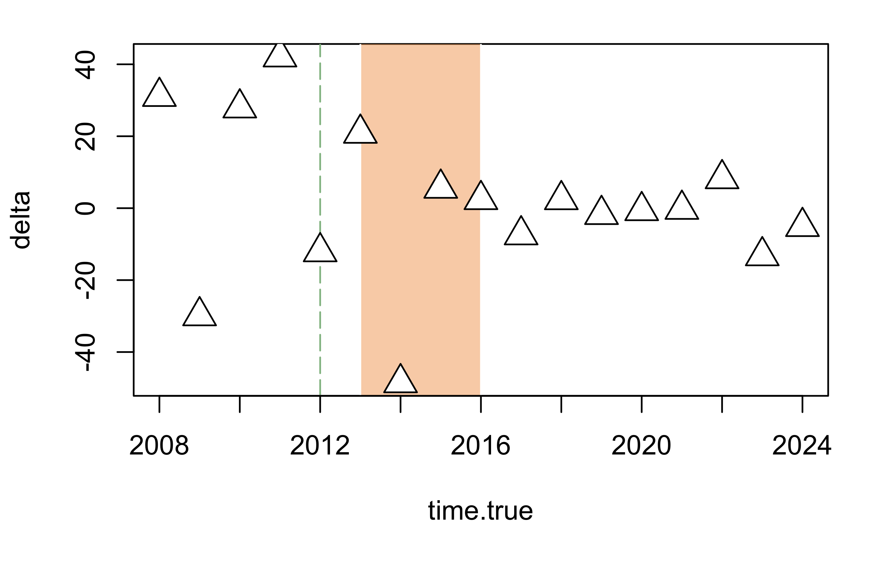
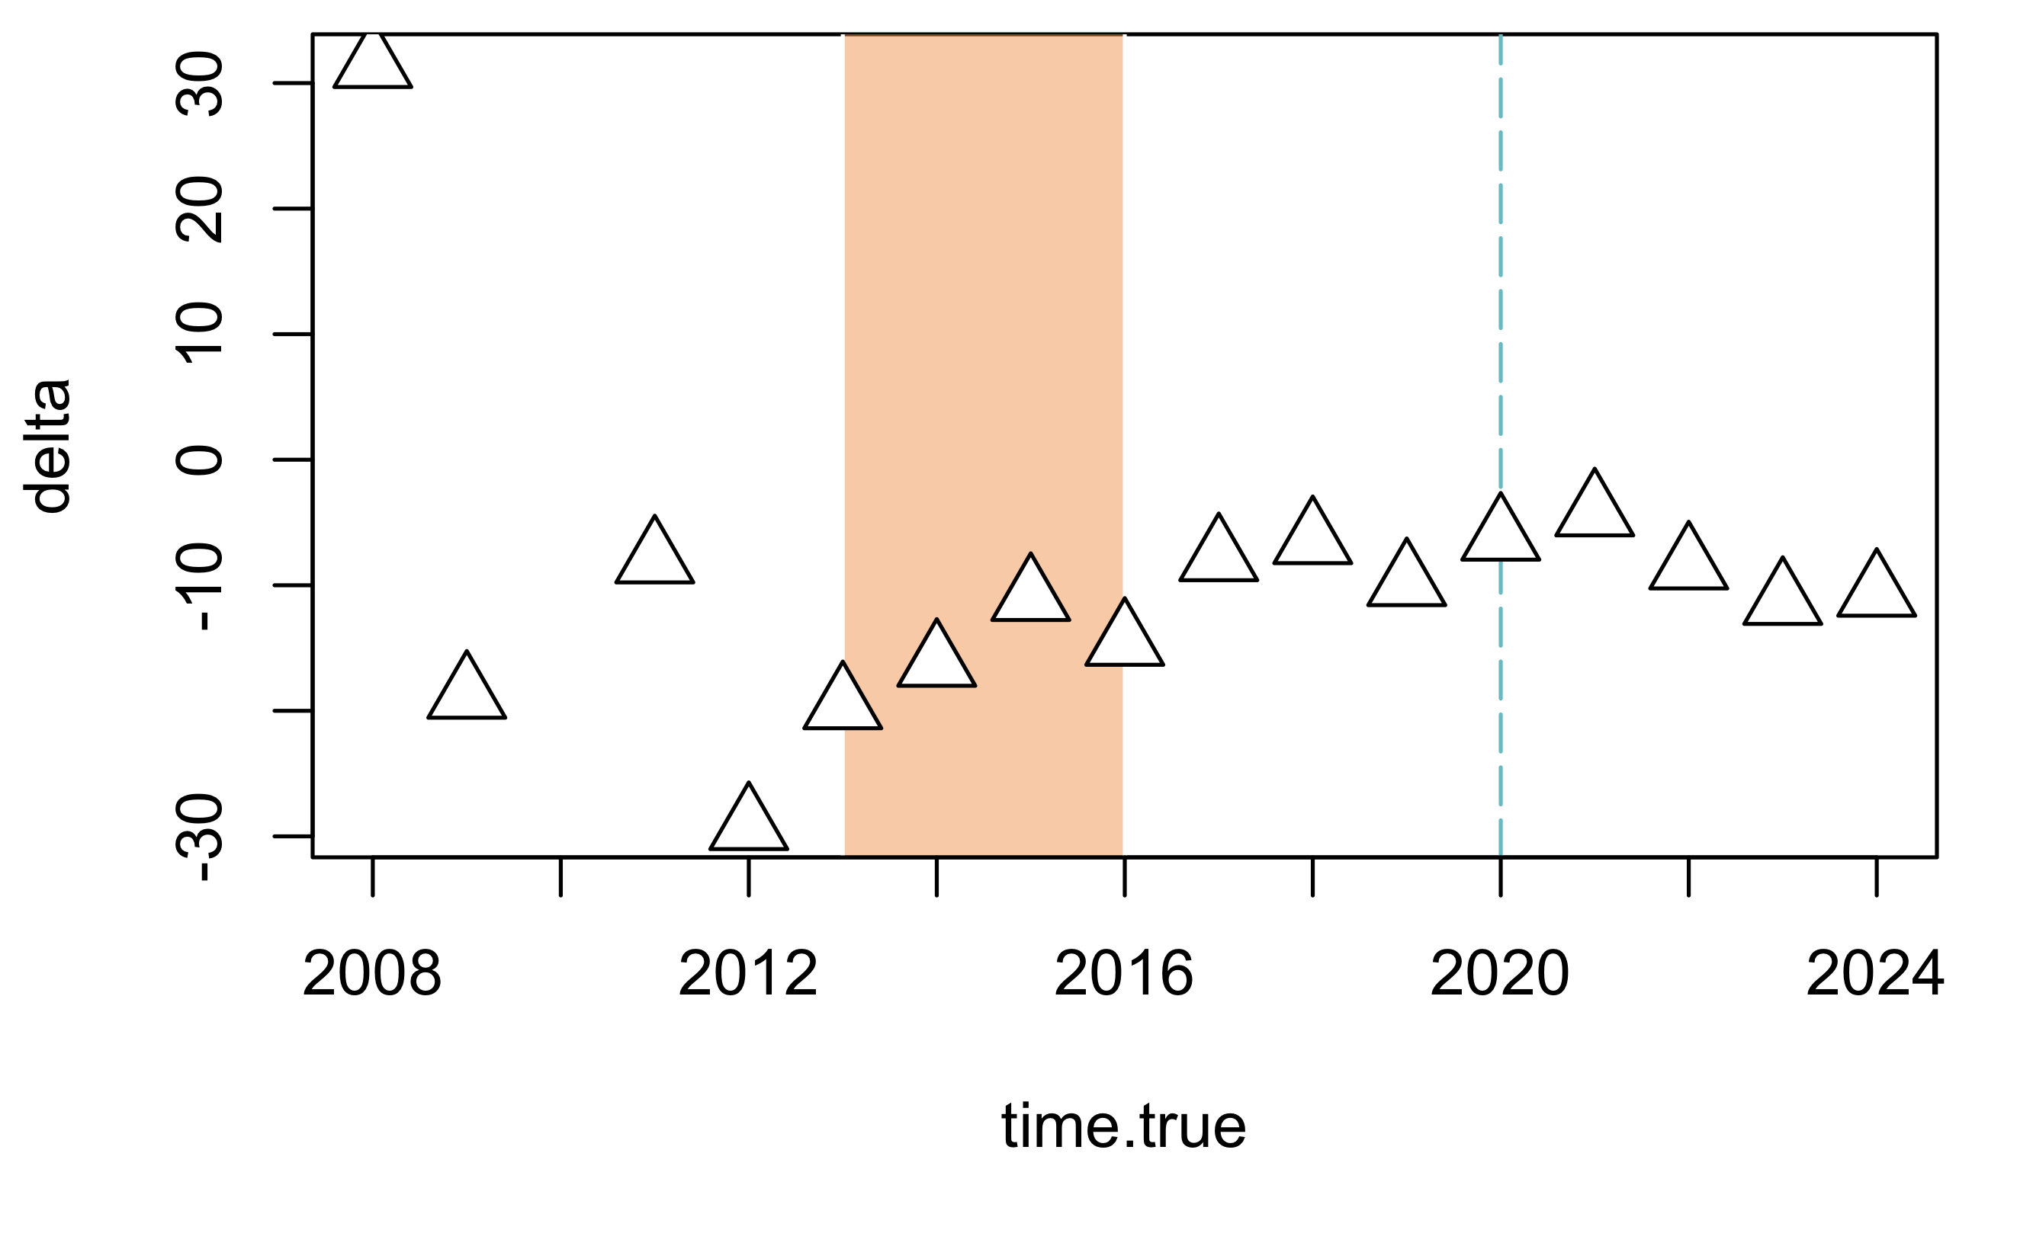
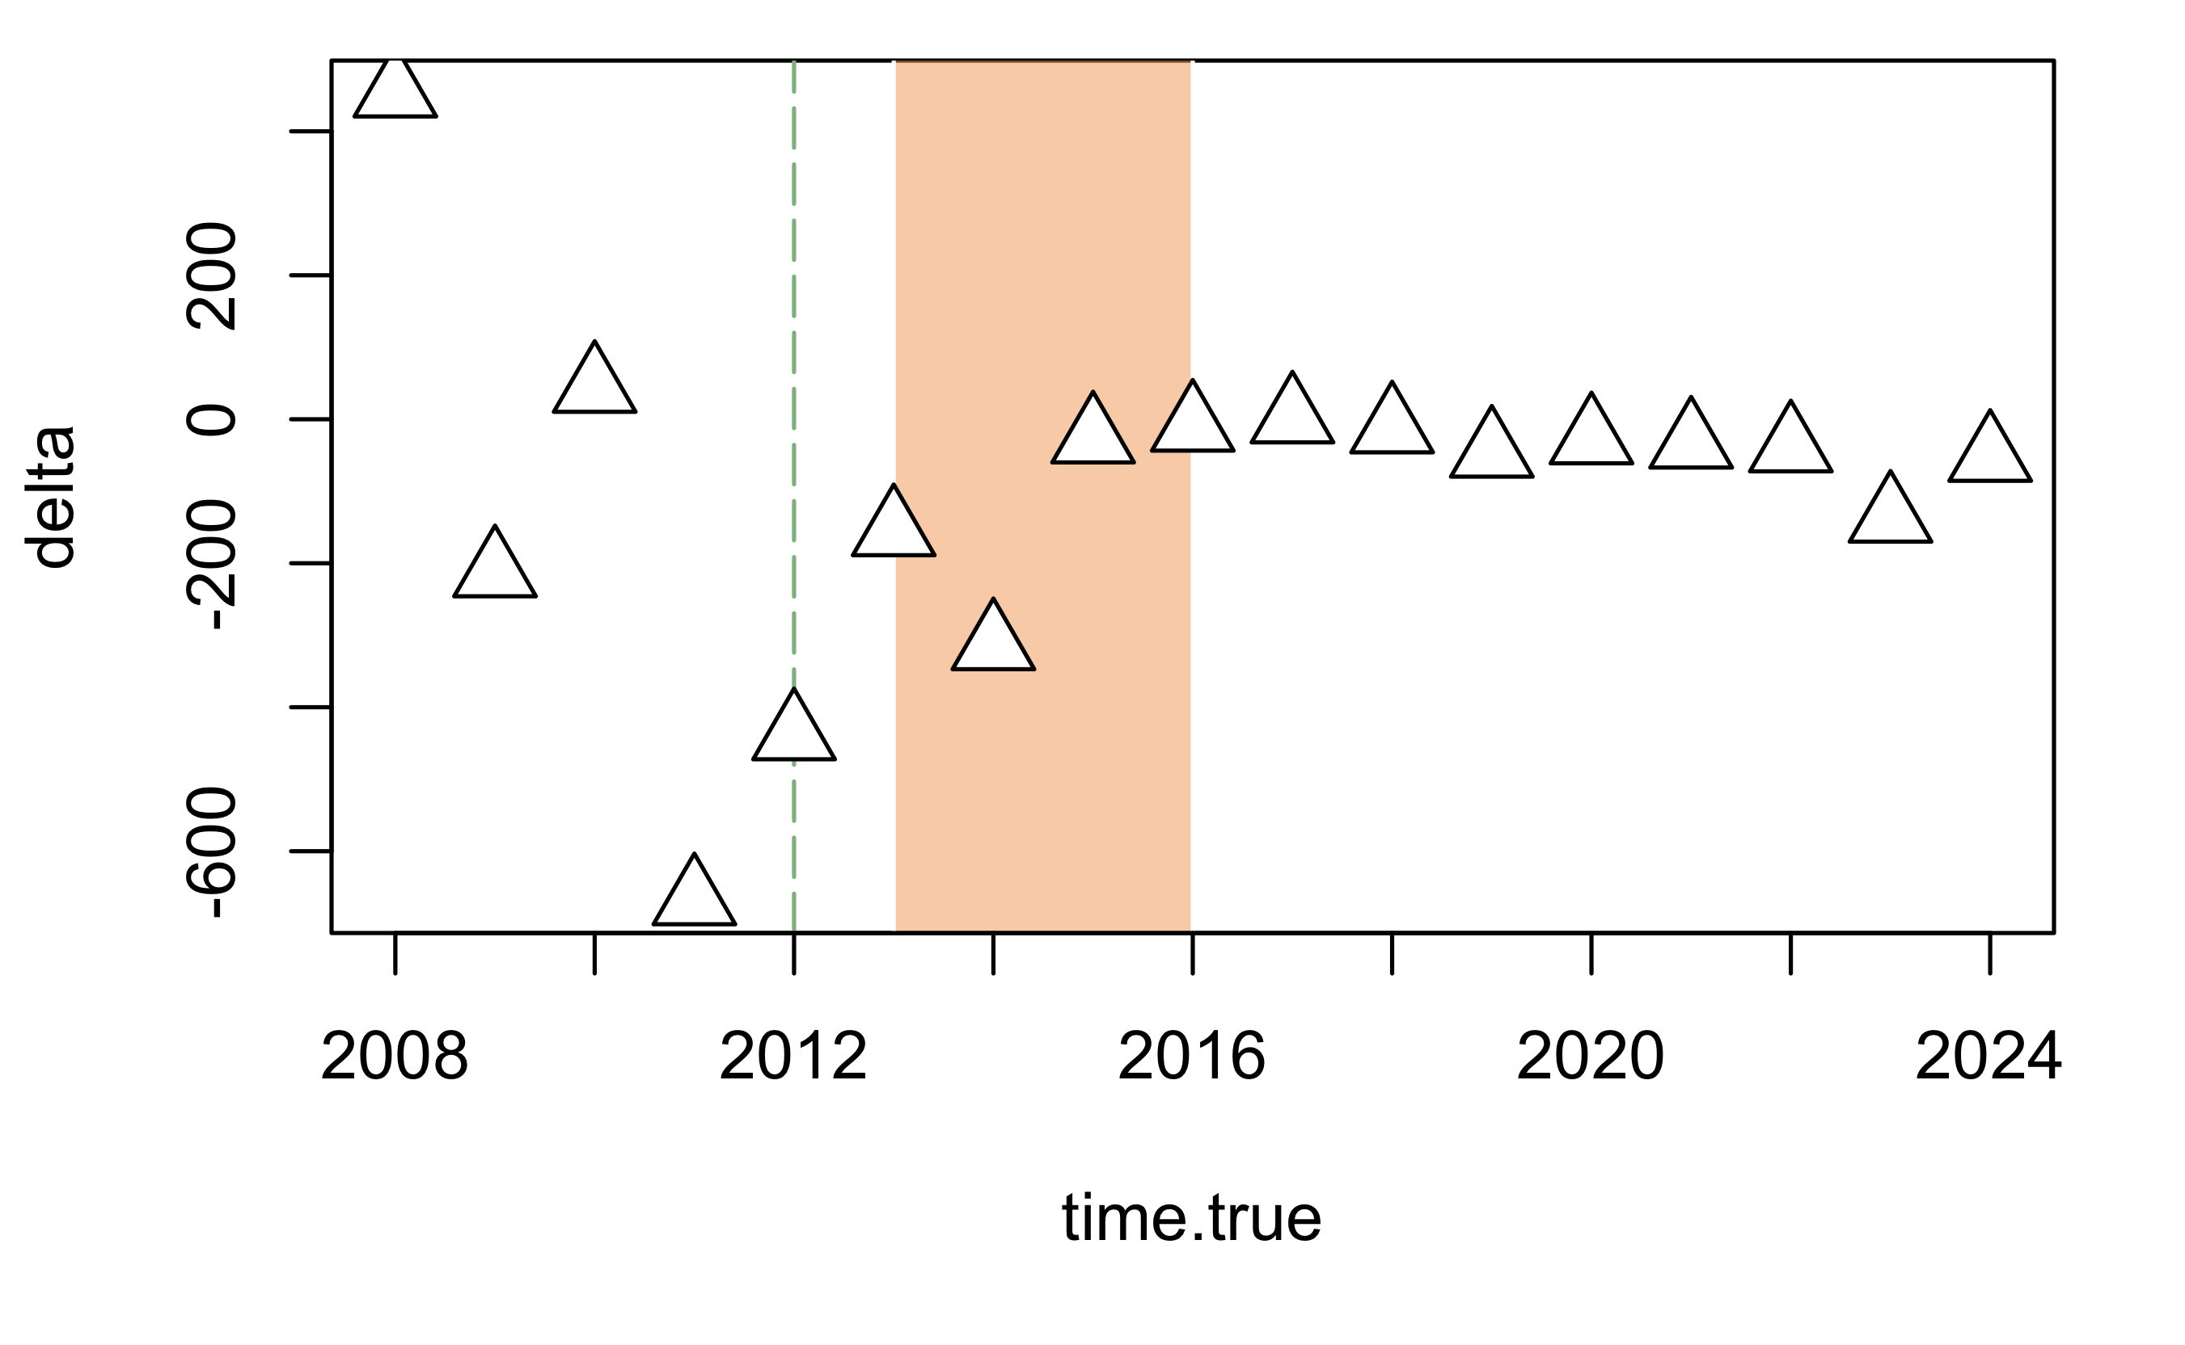
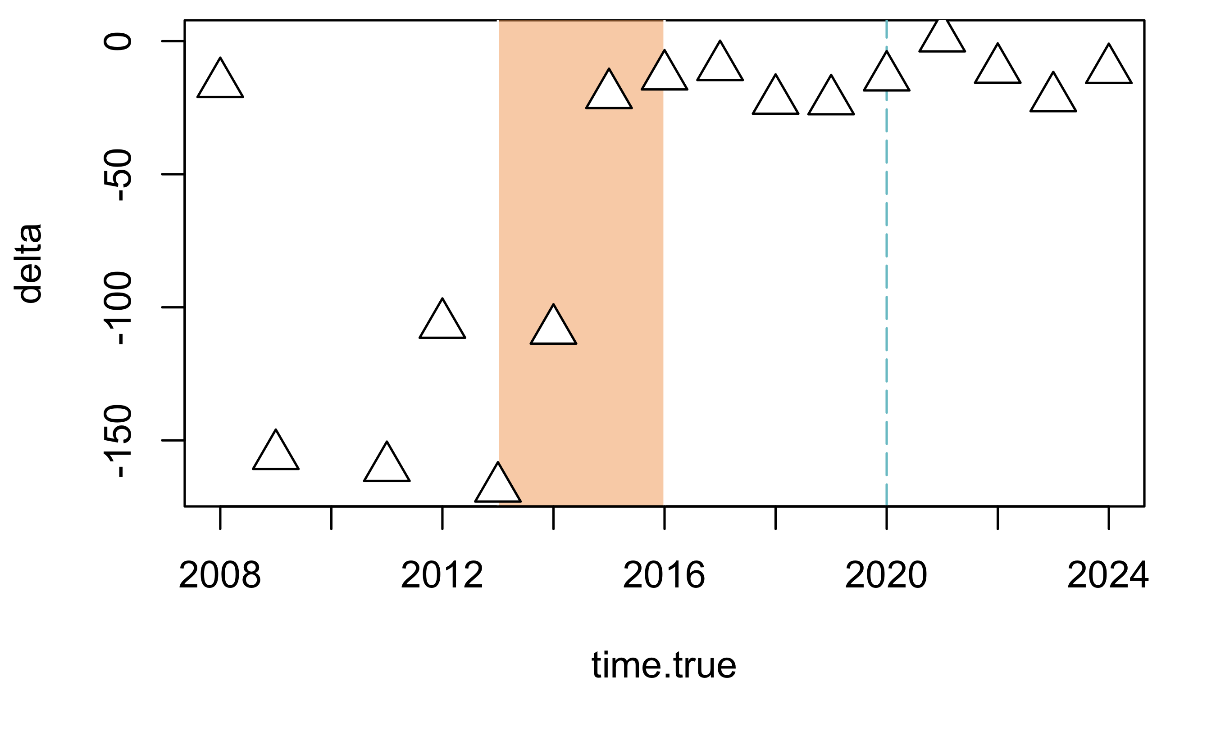
BACIPS Overview - Urchins
Impact: Implementation of MPA
Impact: Implementation of PVR
Step Model, 62.2% likelihood
Step Model, 54.3% likelihood
M. fransciscanus
Linear model, 50.9% likelihood
Sigmoid Model, 62.5% likelihood
S. purpuratus

